Slide 2
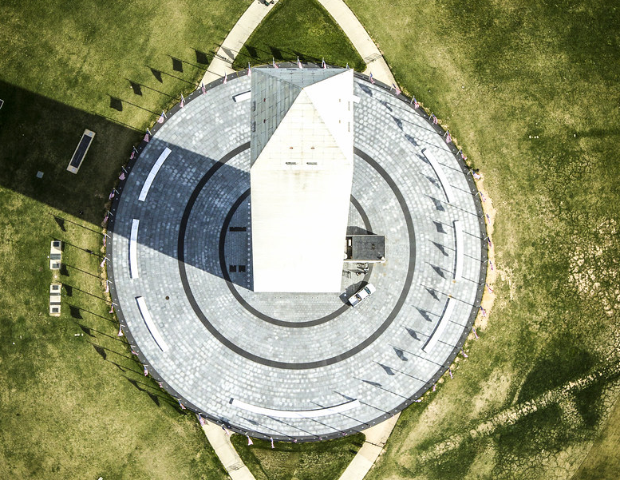
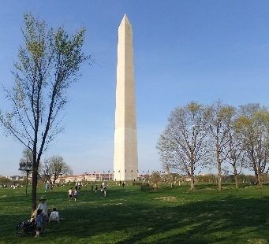

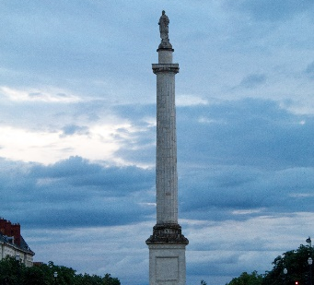

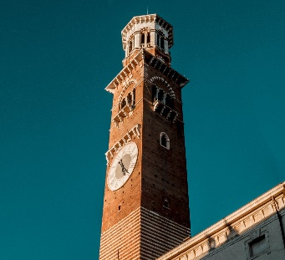
Look at this bird’s-eye view.
Which is the
matching photograph?
Show
Answers
A
B
C
Aerial view of the Washington Monument in Washington.Original from NASA. Digitally enhanced by rawpixel.by Rawpixel Ltd is licensed under CC-BY2.0.

Slide 3
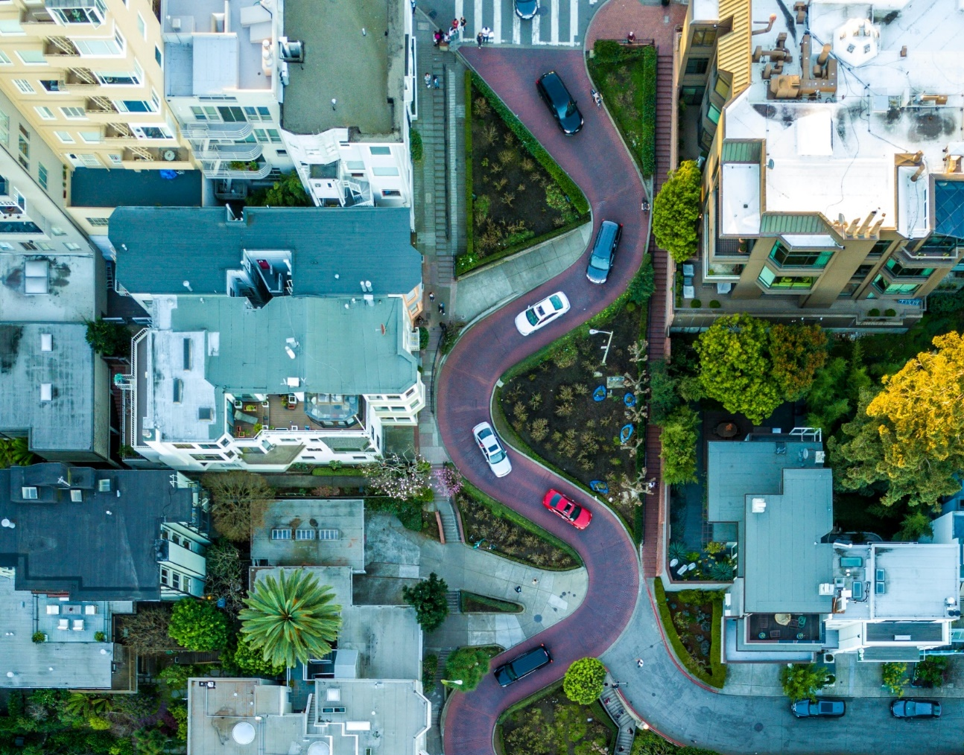
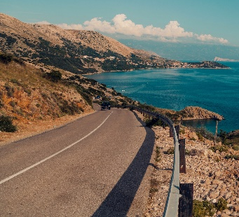
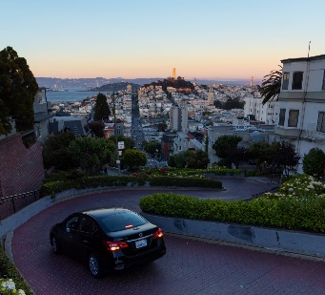
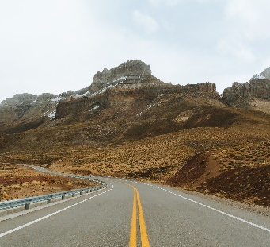
Look at this bird’s-eye view.
Which is the
matching photograph?
Show
Answers
A
B
C

Slide 4
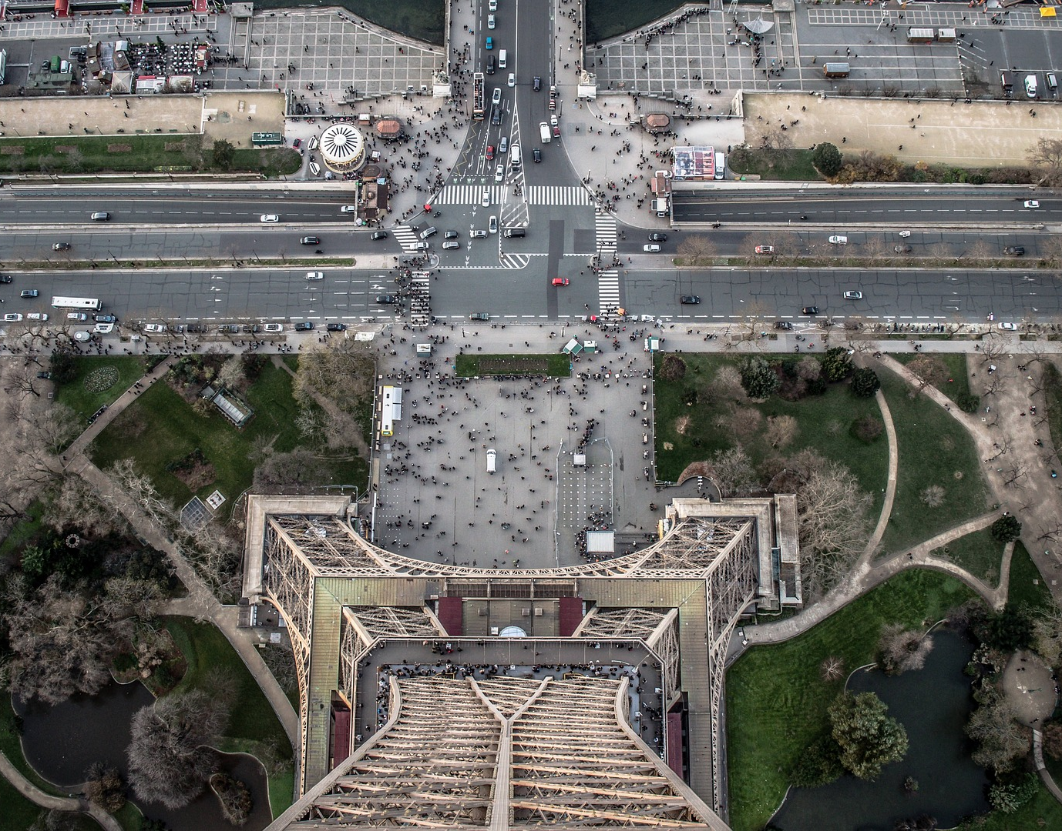
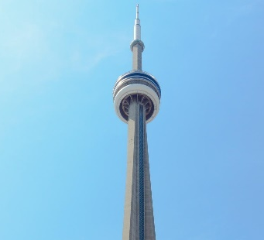
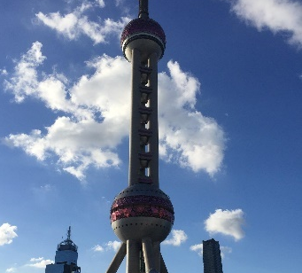
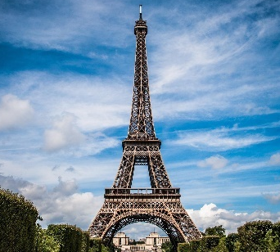
Look at this bird’s-eye view.
Which is the
matching photograph?
Show
Answers
A
B
C

Slide 5
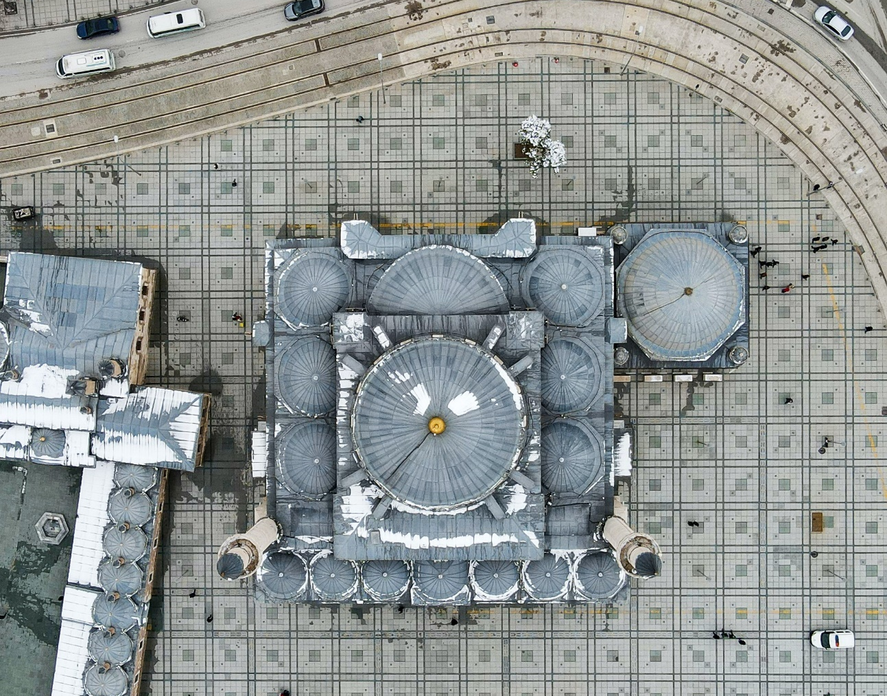
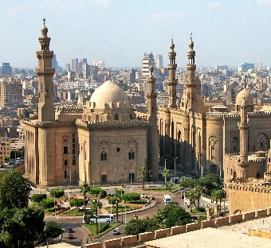
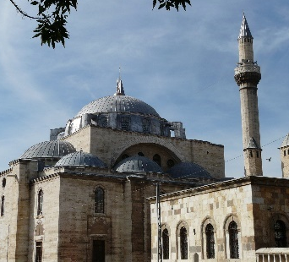
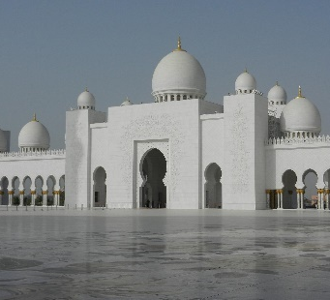
Look at this bird’s-eye view.
Which is the
matching photograph?
Show
Answers
A
B
C

Slide 6
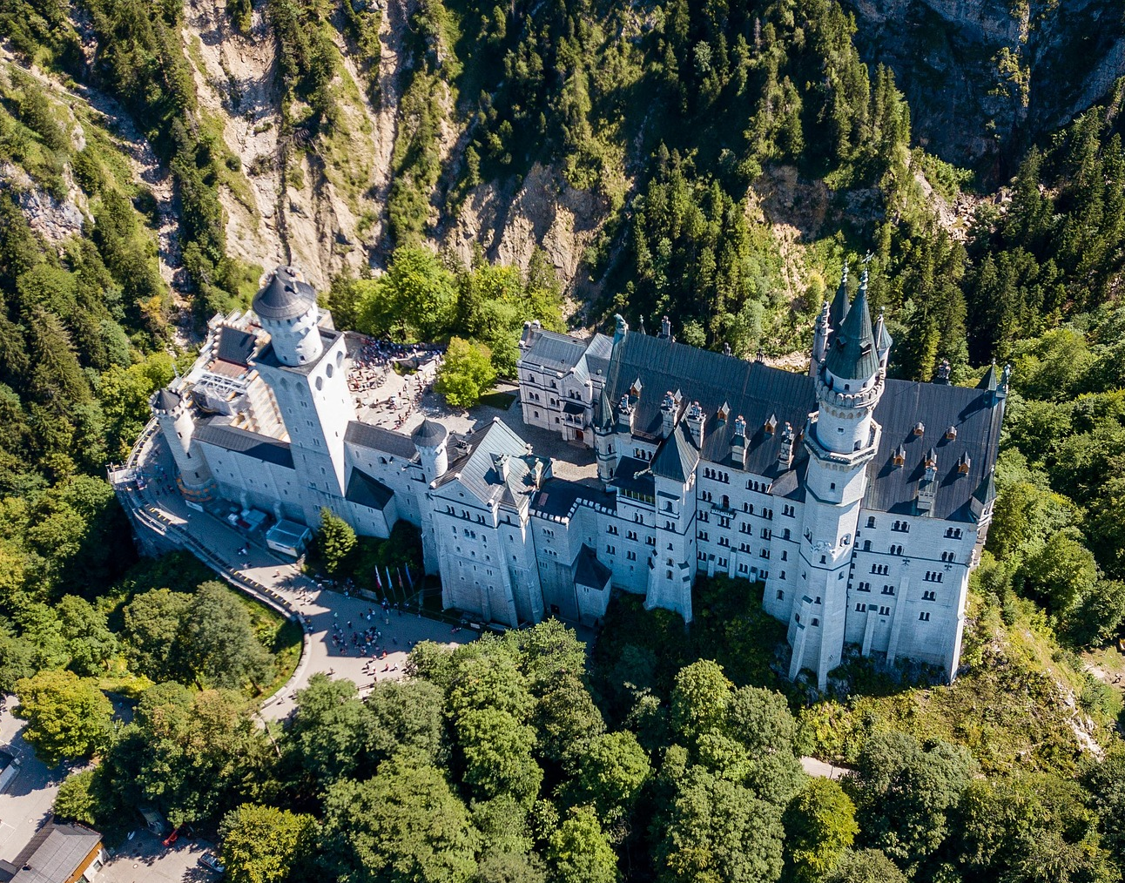
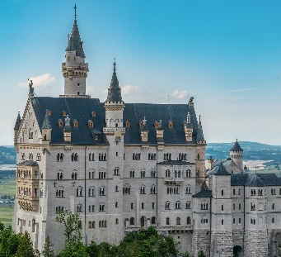
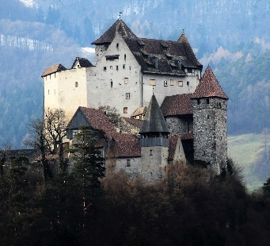
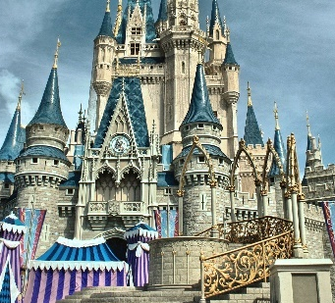
Look at this bird’s-eye view.
Which is the
matching photograph?
Show
Answers
A
B
C

Slide 7
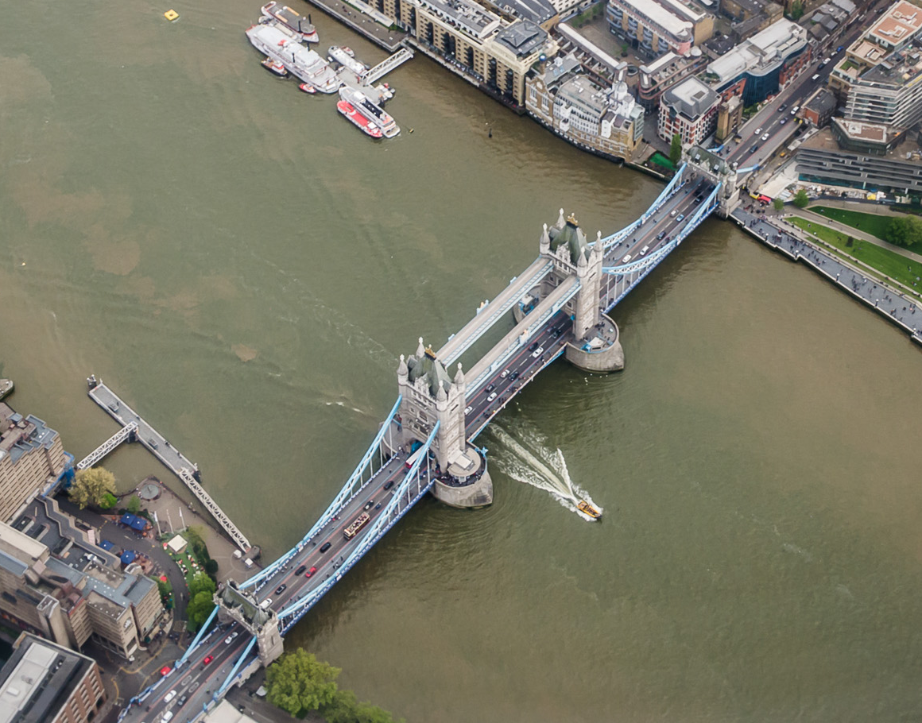
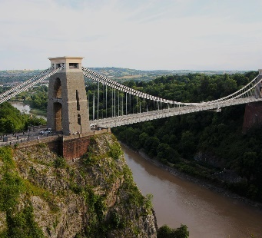
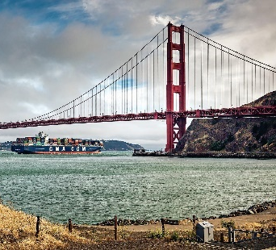
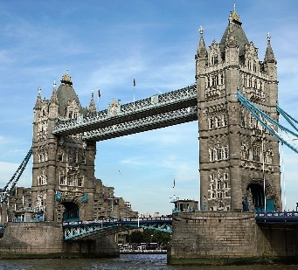
Look at this bird’s-eye view.
Which is the
matching photograph?
Show
Answers
A
B
C
Tower Bridge, aerial view (2015) by Alexander Kachkaev is licensed under CC BY 3.0.

Slide 8

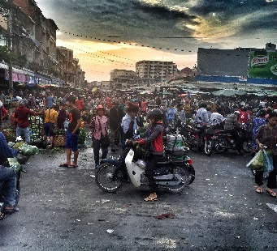


Look at this bird’s-eye view.
Which is the
matching photograph?
Show
Answers
A
B
C

Slide 9
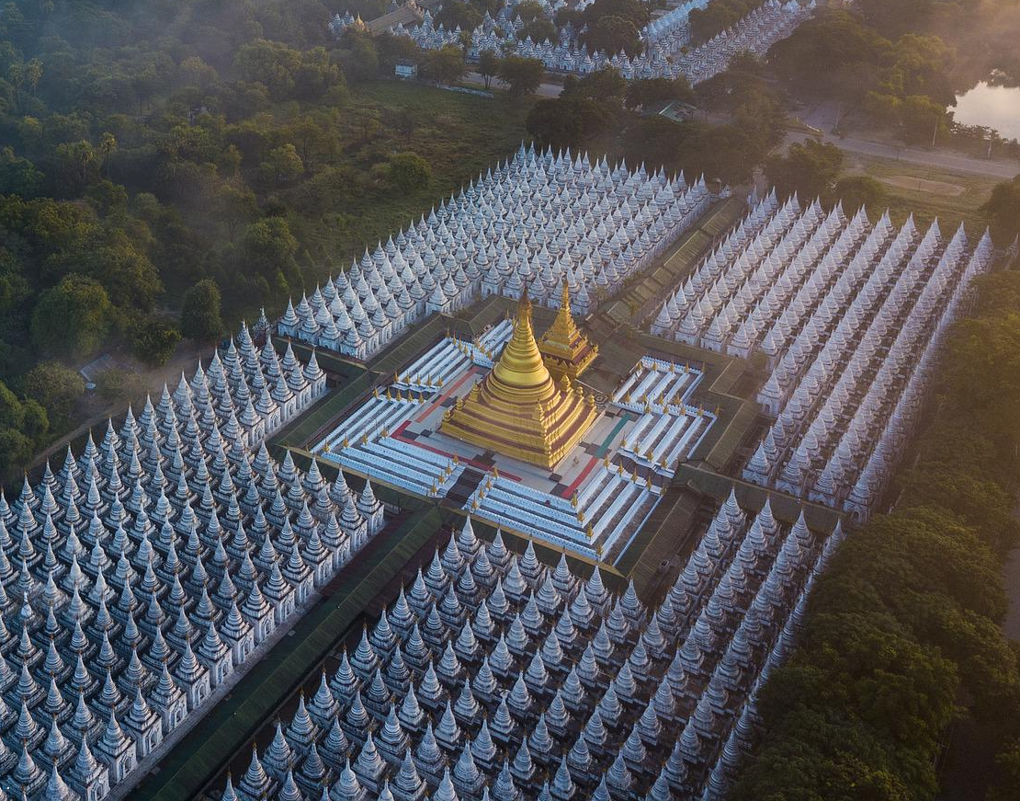
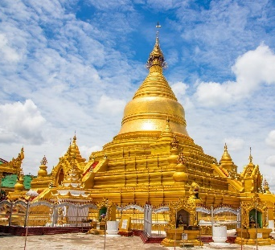


Look at this bird’s-eye view.
Which is the
matching photograph?
Show
Answers
A
B
C

